Slide 1
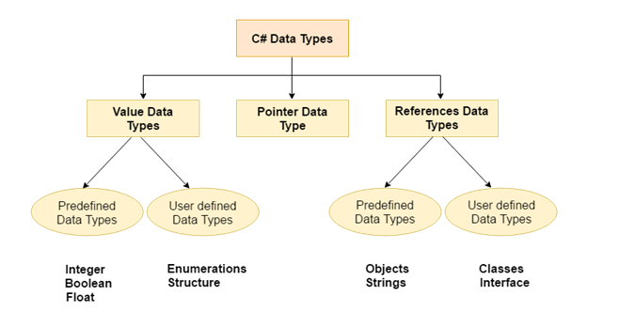
C# Data Types
A data type specifies the type of data that a variable can store such as integer, floating, character etc.

Slide 2
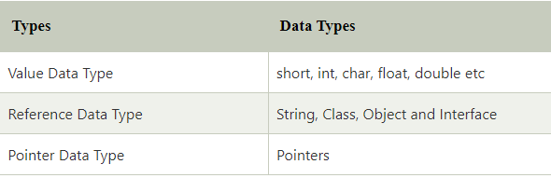
C# Data Types
There are 3 types of data types in C# language.

Slide 3
Next Continue...
Value Types..

